Slide 1
Medium Access Control (MAC) LAYER
COMPUTER NETWORKS

Slide 2
Chapter 4: outline
4.1 Allocation problem for a broadcast channel
- Multiple access problem
4.2. Control access protocols
ALOHA
Slotted ALOHA
CSMA (CA/CD)
Collision-free
4.3. LAN technologies
LAN MAC Address &ARP
Ethernet
Wi-Fi 802.11
WiMax 802.16
Bluetooth
4G LTE
RFID

Slide 3




Multiple access links, protocols
two types of “links”:
Point-to-point (discussed in Chapter 2&3)
PPP for dial-up access
point-to-point link between Ethernet switch, host
Broadcast (shared wire or shared medium)
old-fashioned Ethernet
upstream HFC
802.11 wireless LAN
shared wire (e.g.,
cabled Ethernet)
shared RF
(e.g., 802.11 WiFi)
shared RF
(satellite)
humans at a
cocktail party
(shared air, acoustical)

Slide 4
Multiple access protocols
Single shared broadcast channel
Two or more simultaneous transmissions by nodes: interference
collision if node receives two or more signals at the same time
Multiple Access Protocol
Distributed algorithm that determines how nodes share channel,
When nodes can transmit
Communication about channel sharing must use channel itself!
No out-of-band channel for coordination

Slide 5
An ideal multiple access protocol
Given: broadcast channel of rate R bps
Desired rate:
1. when one node wants to transmit, it can send at rate R.
2. when M nodes want to transmit, each can send at average rate R/M
3. Fully decentralized:
no special node to coordinate transmissions
no synchronization of clocks, slots
4. Simple

Slide 6
MAC protocols: taxonomy
Three broad classes:
channel partitioning
divide channel into smaller “pieces”
time slots (TDMA), frequency (FDMA), code (CDMA)
allocate piece to node for exclusive use
random access
channel not divided, allow collisions
“recover” from collisions
“taking turns”
nodes take turns, but nodes with more to send can take longer turns

Slide 7
Channel partitioning MAC protocols: TDMA
TDMA: time division multiple access
access to channel in "rounds"
each station gets fixed length slot (length = packet transmission time) in each round
unused slots go idle
example: 6-station LAN, 1,3,4 have packets to send, slots 2,5,6 idle
6-slot
frame
6-slot
frame
1
3
4
1
3
4

Slide 8
Channel partitioning MAC protocols: FDMA
FDMA: frequency division multiple access
channel spectrum divided into frequency bands
each station assigned fixed frequency band
unused transmission time in frequency bands go idle
example: 6-station LAN, 1,3,4 have packet to send, frequency bands 2,5,6 idle
time
frequency bands
FDM cable

Slide 9
Chapter 4: outline
4.1 Allocation problem for a broadcast channel
- Multiple access problem
4.2. Control access protocols
ALOHA
Slotted ALOHA
CSMA (CD/CA)
Collision-free
4.3. LAN technologies
LAN MAC Address & ARP
Ethernet
Wi-Fi 802.11
WiMax 802.16
Bluetooth
4G
IoT
RFID

Slide 10
Random access protocols
when node has packet to send
transmit at full channel data rate R.
no a priori coordination among nodes
two or more transmitting nodes at the same time ➜ “collision”,
random access MAC protocol specifies:
how to detect collisions
how to recover from collisions (e.g., via delayed retransmissions)
examples of random access MAC protocols:
ALOHA
slotted ALOHA
CSMA, CSMA/CD, CSMA/CA

Slide 11
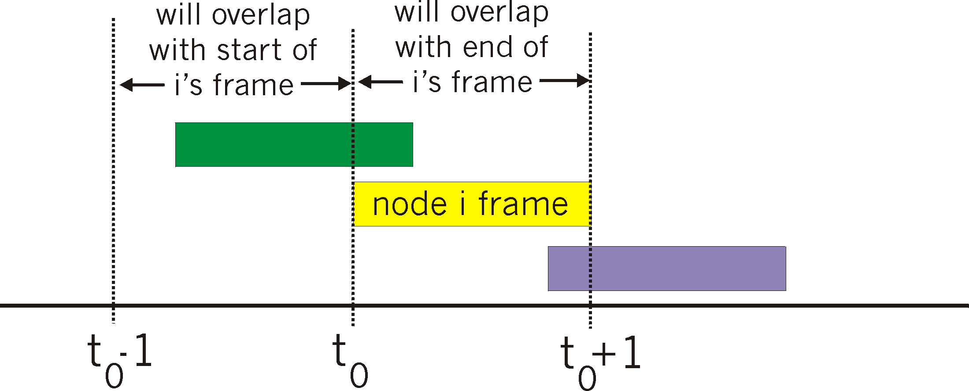
Pure (unslotted) ALOHA
Unslotted Aloha: simpler, no synchronization
when frame first arrives
transmit immediately
collision probability increases:
frame sent at t₀ collides with other frames sent in [t₀-1,t₀+1]

Slide 12
Slotted ALOHA
Assumptions:
all frames same size
time divided into equal size slots (time to transmit 1 frame)
nodes start to transmit only at the beginning of slot
nodes are synchronized
if 2 or more nodes transmit in slot, all nodes detect collision
Operation:
when node obtains fresh frame, transmits in next slot
if no collision: node can send new frame in next slot
if collision: node retransmits frame in each subsequent slot with probability p until success

Slide 13
Slotted ALOHA
node 1
1
1
1
1
node 2
2
2
2
node 3
3
3
3
C
E
C
S
E
C
E
S
S
Pros:
single active node can continuously transmit at full rate of channel
highly decentralized: only slots in nodes need to be in sync
simple
Cons:
collisions, wasting slots
idle slots
nodes may be able to detect collision in less than time to transmit packet
clock synchronization

Slide 14
CSMA (carrier sense multiple access)
CSMA: listen before transmit:
if channel sensed idle: transmit entire frame
if channel sensed busy, defer transmission
human analogy: don’t interrupt others!

Slide 15
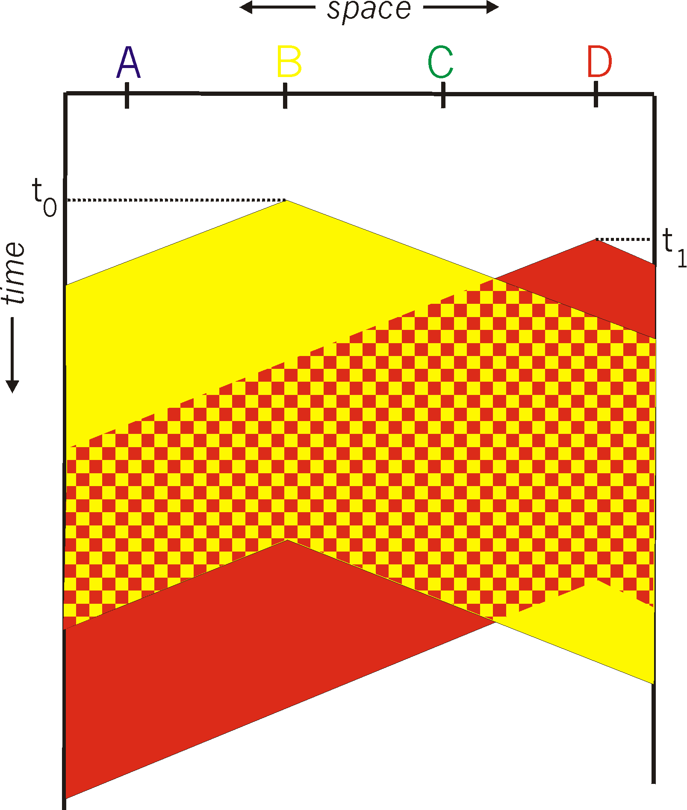
CSMA collisions
spatial layout of nodes
collisions can still occur: propagation delay means two nodes may not hear each other’s transmission
collision: entire packet transmission time wasted
distance & propagation delay play role in in determining collision probability

Slide 16
CSMA/CD (collision detection)
CSMA/CD: carrier sensing, deferral as in CSMA
collisions detected within short time
colliding transmissions aborted, reducing channel wastage
Collision detection:
easy in wired LANs: measure signal strengths, compare transmitted, received signals
difficult in wireless LANs: received signal strength overwhelmed by local transmission strength
Human analogy: the polite conversationalist
https://www.geeksforgeeks.org/collision-detection-csmacd/

Slide 17
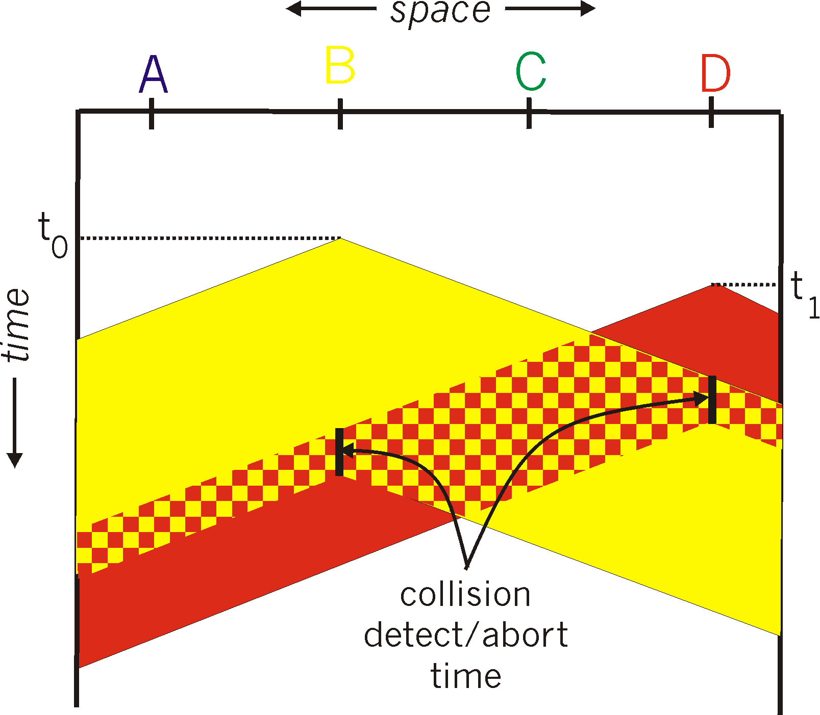
CSMA/CD (collision detection)
spatial layout of nodes

Slide 18
CSMA/CA (CSMA with Collision Avoidance)
A basic collision avoidance (CA) scheme
CSMA/CA rule: Backoff before collision (to avoid collisions)
MS A’s frame
MS B’s frame
Time
Backoff -delay for B
Backoff - delay for C
MSs B & C sense the medium
MS B resenses the medium and transmits its frame
MS C resenses the medium but defers to MS B
(Modified by LTL)

Slide 19
CSMA/CA (CSMA with Collision Avoidance)
When medium idle for a period ≥ DIFS => can transmit immediately
DIFS = Distributed InterFrame Space
In 802.11b networks, DIFS = 50 μs
->
DIFS
© 2006, Michael Hall, Helsinki Univ. of Technology
(Modified by LTL)

Slide 20
“Taking turns” MAC protocols
channel partitioning MAC protocols:
share channel efficiently and fairly at high load
inefficient at low load: delay in channel access, 1/N bandwidth allocated even if only 1 active node!
random access MAC protocols
efficient at low load: single node can fully utilize channel
high load: collision overhead
“taking turns” protocols
look for best of both worlds!

Slide 21

“Taking turns” MAC protocols
polling:
master node “invites” slave nodes to transmit in turn
typically used with “dumb” slave devices
concerns:
polling overhead
latency
single point of failure (master)
data
poll
master
data
slaves

Slide 22
“Taking turns” MAC protocols
token passing:
control token passed from one node to next sequentially.
token message
concerns:
token overhead
latency
single point of failure (token)
T
(nothing
to send)
T
data

Slide 23


Cable access network
Internet frames, TV channels, control transmitted
downstream at different frequencies
cable headend
…
CMTS
…
splitter
cable
modem
cable modem
termination system
ISP
upstream Internet frames, TV control, transmitted
upstream at different frequencies in time slots
multiple 40Mbps downstream (broadcast) channels
single CMTS transmits into channels
multiple 30 Mbps upstream channels
multiple access: all users compete certain upstream channel time slots (others assigned)

Slide 24


Cable access network
cable headend
MAP frame for
Interval [t1, t2]
CMTS
Downstream channel i
Upstream channel j
t₁
t₂
Residences with cable modems
Minislots containing
minislots request frames
Assigned minislots containing cable modem
upstream data frames
DOCSIS: data over cable service interface spec
FDM over upstream, downstream frequency channels
TDM upstream: some slots assigned, some have contention
downstream MAP frame: assigns upstream slots
request for upstream slots (and data) transmitted random access (binary backoff) in selected slots

Slide 25
Summary of MAC protocols
channel partitioning, by time, frequency or code
Time Division, Frequency Division
random access (dynamic),
ALOHA, S-ALOHA, CSMA, CSMA/CD
carrier sensing: easy in some technologies (wire), hard in others (wireless)
CSMA/CD used in Ethernet
CSMA/CA used in 802.11
taking turns
polling from central site, token passing
Bluetooth, FDDI, token ring

Slide 26
Exercise
Compare CSMA/CD vs CSMA/CA ?

Slide 27
Chapter 4: outline
4.1 Allocation problem for a broadcast channel
- Multiple access problem
4.2. Control access protocols
ALOHA
Slotted ALOHA
CSMA (CD/CA)
Collision-free
4.3. LAN technologies
LAN MAC Address & ARP
Ethernet
Wi-Fi 802.11
WiMax 802.16
Bluetooth
4G
IoT
RFID

Slide 28
MAC addresses and ARP
32-bit IP address:
network-layer address for interface
used for layer 3 (network layer) forwarding
MAC (or LAN or physical or Ethernet) address:
function: used ‘locally” to get frame from one interface to another physically-connected interface (same network, in IP-addressing sense)
48 bit MAC address (for most LANs) burned in NIC ROM, also sometimes software settable
e.g.: 1A-2F-BB-76-09-AD
hexadecimal (base 16) notation
(each “numeral” represents 4 bits)

Slide 29

MAC addresses and ARP
each adapter on LAN has unique MAC address
1A-2F-BB-76-09-AD
LAN
(wired or
wireless)
adapter
71-65-F7-2B-08-53
58-23-D7-FA-20-B0
0C-C4-11-6F-E3-98

Slide 30
MAC addresses (more)
MAC address allocation administered by IEEE
manufacturer buys portion of MAC address space (to assure uniqueness)
analogy:
MAC address: like Social Security Number
IP address: like postal address
MAC flat address ➜ portability
can move LAN card from one LAN to another
IP hierarchical address not portable
address depends on IP subnet to which node is attached

Slide 31




ARP: address resolution protocol
Question: how to determine
interface’s MAC address, knowing its IP address?
ARP table: each IP node (host, router) on LAN has table
IP/MAC address mappings for some LAN nodes:
< IP address; MAC address; TTL>
TTL (Time To Live): time after which address mapping will be forgotten (typically 20 min)
137.196.7.78
1A-2F-BB-76-09-AD
137.196.7.23
137.196.7.14
LAN
71-65-F7-2B-08-53
58-23-D7-FA-20-B0
0C-C4-11-6F-E3-98
137.196.7.88

Slide 32
ARP protocol: same LAN
A wants to send datagram to B
B’s MAC address not in A’s ARP table.
A broadcasts ARP query packet, containing B's IP address
destination MAC address = FF-FF-FF-FF-FF-FF
all nodes on LAN receive ARP query
B receives ARP packet, replies to A with its (B's) MAC address
frame sent to A’s MAC address (unicast)
A caches (saves) IP-to-MAC address pair in its ARP table until information becomes old (times out)
soft state: information that times out (goes away) unless refreshed
ARP is “plug-and-play”:
nodes create their ARP tables without intervention from net administrator

Slide 33




Addressing: routing to another LAN
walkthrough: send datagram from A to B via R
focus on addressing – at IP (datagram) and MAC layer (frame)
assume A knows B’s IP address
assume A knows IP address of first hop router, R (how?)
assume A knows R’s MAC address (how?)
A
B
R
111.111.111.111
222.222.222.222
74-29-9C-E8-FF-55
49-BD-D2-C7-56-2A
222.222.222.220
1A-23-F9-CD-06-9B
111.111.111.112
111.111.111.110
222.222.222.221
CC-49-DE-D0-AB-7D
E6-E9-00-17-BB-4B
88-B2-2F-54-1A-0F

Slide 34
Addressing: routing to another LAN
A creates IP datagram with IP source A, destination B
A creates link-layer frame with R's MAC address as destination address, frame contains A-to-B IP datagram
MAC src: 74-29-9C-E8-FF-55
MAC dest: E6-E9-00-17-BB-4B
IP
Eth
Phy
IP src: 111.111.111.111
IP dest: 222.222.222.222
A
B
R
111.111.111.111
222.222.222.222
74-29-9C-E8-FF-55
49-BD-D2-C7-56-2A
222.222.222.220
1A-23-F9-CD-06-9B
111.111.111.112
111.111.111.110
222.222.222.221
CC-49-DE-D0-AB-7D
E6-E9-00-17-BB-4B
88-B2-2F-54-1A-0F

Slide 35
Addressing: routing to another LAN
frame sent from A to R
frame received at R, datagram removed, passed up to IP
MAC src: 74-29-9C-E8-FF-55
MAC dest: E6-E9-00-17-BB-4B
IP src: 111.111.111.111
IP dest: 222.222.222.222
IP
Eth
Phy
IP src: 111.111.111.111
IP dest: 222.222.222.222
IP
Eth
Phy
A
B
R
111.111.111.111
222.222.222.222
74-29-9C-E8-FF-55
49-BD-D2-C7-56-2A
222.222.222.220
1A-23-F9-CD-06-9B
111.111.111.112
111.111.111.110
222.222.222.221
CC-49-DE-D0-AB-7D
E6-E9-00-17-BB-4B
88-B2-2F-54-1A-0F

Slide 36
Addressing: routing to another LAN
R forwards datagram with IP source A, destination B
R creates link-layer frame with B's MAC address as destination address, frame contains A-to-B IP datagram
MAC src: 1A-23-F9-CD-06-9B
MAC dest: 49-BD-D2-C7-56-2A
IP
Eth
Phy
IP
Eth
Phy
IP src: 111.111.111.111
IP dest: 222.222.222.222
A
B
R
111.111.111.111
222.222.222.222
74-29-9C-E8-FF-55
49-BD-D2-C7-56-2A
222.222.222.220
1A-23-F9-CD-06-9B
111.111.111.112
111.111.111.110
222.222.222.221
CC-49-DE-D0-AB-7D
E6-E9-00-17-BB-4B
88-B2-2F-54-1A-0F

Slide 37
Addressing: routing to another LAN
R forwards datagram with IP source A, destination B
R creates link-layer frame with B's MAC address as destination address, frame contains A-to-B IP datagram
MAC src: 1A-23-F9-CD-06-9B
MAC dest: 49-BD-D2-C7-56-2A
IP
Eth
Phy
IP
Eth
Phy
IP src: 111.111.111.111
IP dest: 222.222.222.222
A
B
R
111.111.111.111
222.222.222.222
74-29-9C-E8-FF-55
49-BD-D2-C7-56-2A
222.222.222.220
1A-23-F9-CD-06-9B
111.111.111.112
111.111.111.110
222.222.222.221
CC-49-DE-D0-AB-7D
E6-E9-00-17-BB-4B
88-B2-2F-54-1A-0F

Slide 38
Addressing: routing to another LAN
R forwards datagram with IP source A, destination B
R creates link-layer frame with B's MAC address as dest, frame contains A-to-B IP datagram
MAC src: 1A-23-F9-CD-06-9B
MAC dest: 49-BD-D2-C7-56-2A
IP src: 111.111.111.111
IP dest: 222.222.222.222
IP
Eth
Phy
A
B
R
111.111.111.111
222.222.222.222
74-29-9C-E8-FF-55
49-BD-D2-C7-56-2A
222.222.222.220
1A-23-F9-CD-06-9B
111.111.111.112
111.111.111.110
222.222.222.221
CC-49-DE-D0-AB-7D
E6-E9-00-17-BB-4B
88-B2-2F-54-1A-0F
* Check out the online interactive exercises for more examples: http://gaia.cs.umass.edu/kurose_ross/interactive/

Slide 39
Chapter 4: outline
4.1 Allocation problem for a broadcast channel
- Multiple access problem
4.2. Control access protocols
ALOHA
Slotted ALOHA
CSMA (CD/CA)
Collision-free
4.3. LAN technologies
LAN MAC Address & ARP
Ethernet 802.3
Wi-Fi 802.11
WiMax 802.16
Bluetooth
4G
IoT
RFID

Slide 40
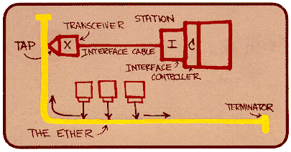
Ethernet
“dominant” wired LAN technology:
single chip, multiple speeds (e.g., Broadcom BCM5761)
first widely used LAN technology
simpler, cheap
kept up with speed race: 10 Mbps – 10 Gbps
Metcalfe’s Ethernet sketch

Slide 41



Ethernet: physical topology
bus: popular through mid 90s
all nodes in same collision domain
can collide with each other
star: prevails today
active switch in center
each “spoke” runs a (separate) Ethernet protocol
nodes do not collide with each other
switch
star
bus: coaxial cable

Slide 42
Ethernet frame structure
Sending adapter encapsulates IP datagram (or other network layer protocol packet) in Ethernet frame
preamble:
7 bytes with pattern 10101010 followed by one byte with pattern 10101011
used to synchronize receiver, sender clock rates
type
preamble
dest.
address
source
address
data (payload)
CRC

Slide 43
Ethernet frame structure (more)
addresses: 6 byte source, destination MAC addresses
if adapter receives frame with matching destination address, or with broadcast address (e.g. ARP packet), it passes data in frame to network layer protocol
otherwise, adapter discards frame
type: indicates higher layer protocol (mostly IP but others possible, e.g., Novell IPX, AppleTalk)
CRC: cyclic redundancy check at receiver
error detected: frame is dropped
type
preamble
dest.
address
source
address
data (payload)
CRC

Slide 44
Ethernet: unreliable, connectionless
connectionless: no handshaking between sending and receiving NICs
unreliable: receiving NIC doesn't send acks or nacks to sending NIC
data in dropped frames recovered only if initial sender uses higher layer rdt (e.g., TCP), otherwise dropped data lost
Ethernet’s MAC protocol: unslotted CSMA/CD with binary backoff

Slide 45
802.3 Ethernet standards: link & physical layers
many different Ethernet standards
common MAC protocol and frame format
different speeds: 2 Mbps, 10 Mbps, 100 Mbps, 1Gbps, 10 Gbps, 40 Gbps
different physical layer media: fiber, cable
application
transport
network
link
physical
MAC protocol
and frame format
100BASE-TX
100BASE-T2
100BASE-FX
100BASE-T4
100BASE-SX
100BASE-BX
copper (twister
pair) physical layer
fiber physical layer

Slide 46
Ethernet (IEEE 802.3)
Classic Ethernet
Shared medium
2.5 km max + 4 repeaters
Switched Ethernet
Fast Ethernet : 100 Mbps (0.1 Gbps)
Gigabit Ethernet (1 Gbps)
10 Gigabit Ethernet (10 Gbps)
Thick Ethernet : 500 m, 100 users
Thin Ethernet: 185 m, 30 users

Slide 47
Ethernet: CSMA/CD with Binary Exponential Backoff
After i’th consecutive collision, the sender nodes wait a random number of time slots between 0 and 2^i − 1.
Each Time slot = 51.2 μsec = 512 bit times
after 10 collisions, the interval is frozen at maximum 1023 slots.
After 16 collisions, the controller reports failure back

Slide 48
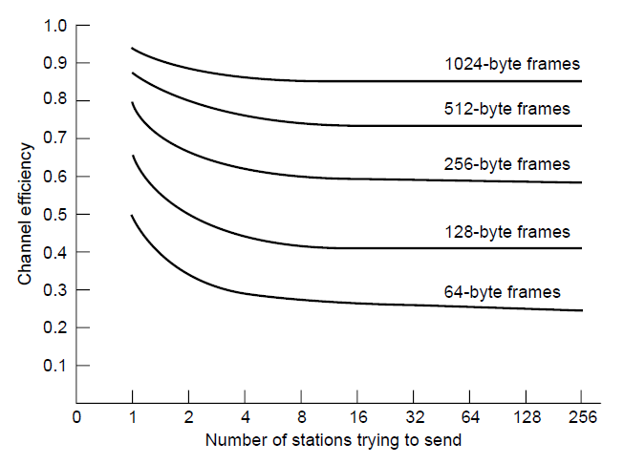
Efficiency of Ethernet at 10 Mbps with 512-bit slot times

Slide 49
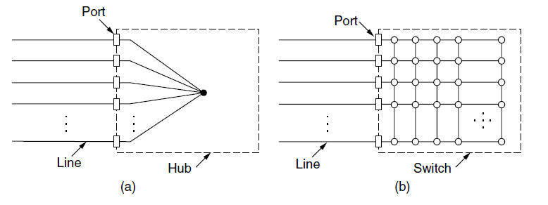
Switched Ethernet (1)
(a) Hub. (b) Switch.

Slide 50
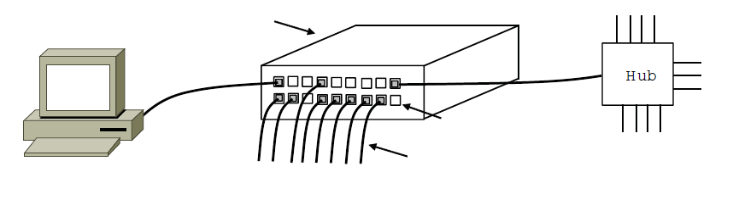
Switched Ethernet (2)
Switch
Hub
Switch ports
Twisted pair
An Ethernet switch.

Slide 51
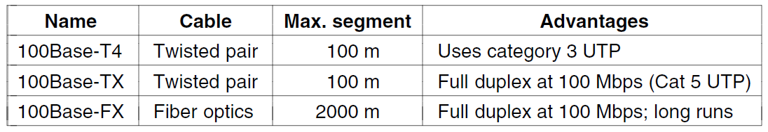
Fast Ethernet
100B-T4: uses 4 twisted pairs with 25 MHz BW. 1 to the switch, 1 from the switch and other 2 are interchangeable. Using 3 voltage levels for symbols. Manchester encoding.
100B-TX: 4B/5B encoding. 125 MHz BW results 100 Mbps. 2 pairs of cable required.
100B-FX: only works with switches because the maximum cable length should be less than 250 m for CD to work.

Slide 52
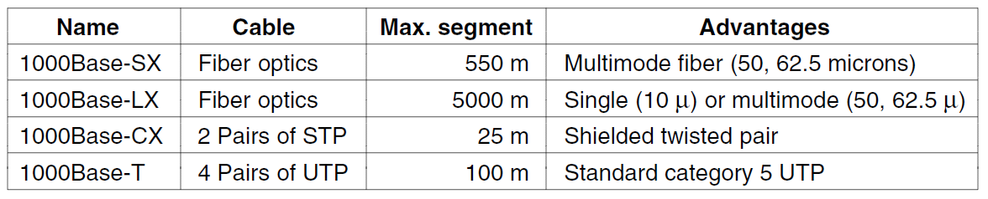
Gigabit Ethernet
Two ways to enhance cable length to 200 m when using hubs:
Hardware carrier extension to 512 bytes.
frame bursting
8B/10B encoding is used to maintain synchronization.
In UTP cables all 4 pairs are used in simultaneous full-duplex mode! With 5 voltage levels
Pause frames are defined to cease the communication speed.

Slide 53
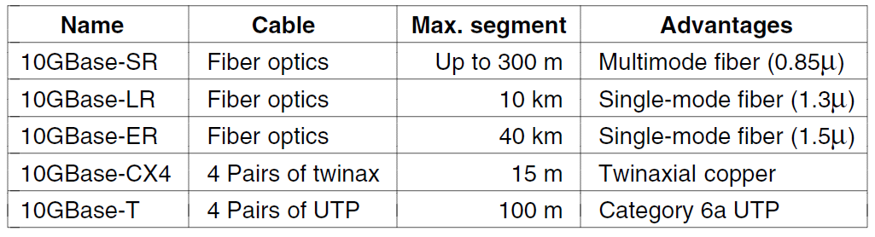
10 Gigabit Ethernet
Fiber cables use 64B/66B coding is used.
CX cables use 8B/10B coding and 3.125 Gsymbol/sec on each pair.
T cabling requires 16 voltage levels. LDPC (Low Density Parity Check) is used.
40Gbps and 100Gbps Ethernet standards are in the way.

Slide 54
Ethernet benefits
Reliable: by introducing switches
Cheap: twisted pairs and NICs
Easy to maintain: no software requirement. Easy configuration.
Well integration with IP: both are connection less.
Flexible: evolve by time in speed requirements with minimum reconfiguration and changes.

Slide 55
Wireless LAN 802.11
802.11 architecture and protocol stack
802.11 physical layer
802.11 MAC sublayer protocol
802.11 frame structure
Services

Slide 56
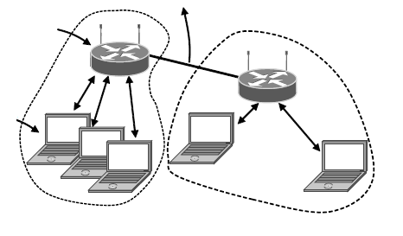
802.11 Architecture and Protocol Stack (1)
To Network
Access Point
Client
802.11 architecture – infrastructure mode

Slide 57
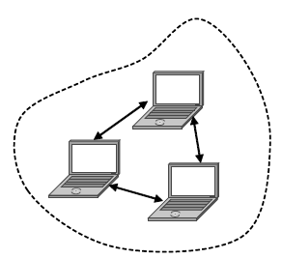
802.11 Architecture and Protocol Stack (2)
802.11 architecture – ad-hoc mode-

Slide 58
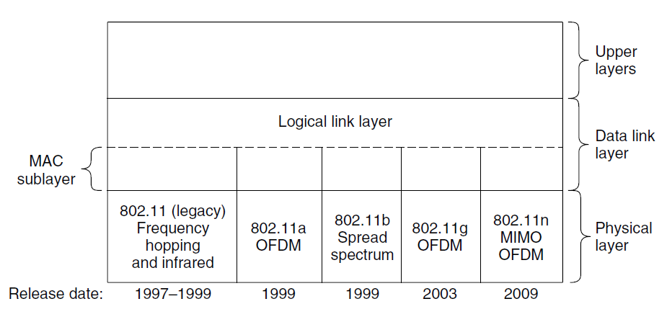
802.11 Protocol Stack
1-2 Mbps 11 Mbps 54 Mbps 600 Mbps

Slide 59
802.11b PHY Layer
1 Mbps : 11 chip barker code to spread the signal with BPSK to send 1 bit per 11 chip. The chip rate is 11 Mchips/sec.
2 Mbps : QPSK to send 2 bits per 11 chip.
5.5 Mbps: CCK (Complementary Code Keying) with 4 bits per 8 chips.
11 Mbps: CCK with 8 bits per 8 chips.

Slide 60
802.11a, g, n PHY Layer
802.11a Works in 5GHz band.
Uses OFDM with 52 subcarriers 48 for data and 4 for sync.
Each symbol lasts 4μs and sends 1, 2, 4, or 6 bits.
Supports 8 data rates from 6 up to 54Mbps.
Communication range is 1/7 802.11b because of freq. band.
802.11 g uses OFDM in 2.4GHz band.
Supports same rates of 802.11a with same range of 802.11b
802.11n doubles the channel width from 20 to 40MHz.
Uses multiple antennas and MIMO techniques to increase BW.

Slide 61
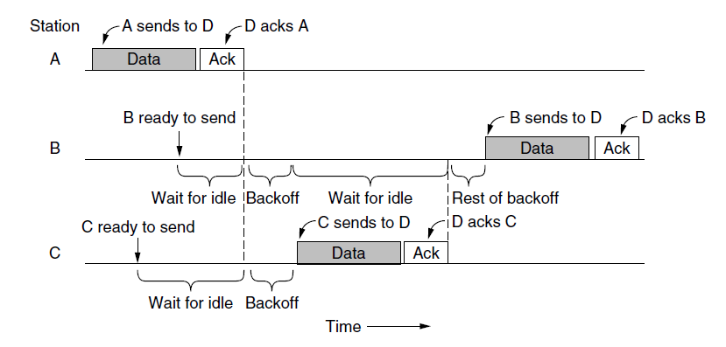
The 802.11 MAC Sublayer Protocol
Sending a frame with CSMA/CA.
The initial backoff gets exponentially bigger if no ack is received.

Slide 62
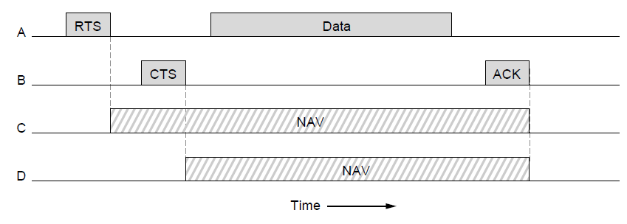
Collision Avoidance mechanism
The use of virtual channel sensing using CSMA/CA.
NAV (Network Allocation Vector)
https://en.wikipedia.org/wiki/IEEE_802.11_RTS/CTS

Slide 63
CSMA/CA
RTS/CTS mechanism is seldom used, because it slows down the communication.
The random back-off mechanism as well as virtual carrier sensing (by overhearing the NAV field) are the main mechanisms to avoid collision.
Fragmentation is also used to keep the frame error rates small.
Fragments are sent in bursts when channel is acquired and each fragment should be acknowledged before the next one is sent.

Slide 64
Power management
Nodes go to sleep mode and inform AP of it.
AP buffers traffic for sleeping nodes.
AP sends periodic beacons to announce which node has a buffered frame.
Nodes should wake up at beacon intervals (typically 100msec) to see if they have frames.
If so they tell the AP to send them the frames.

Slide 65
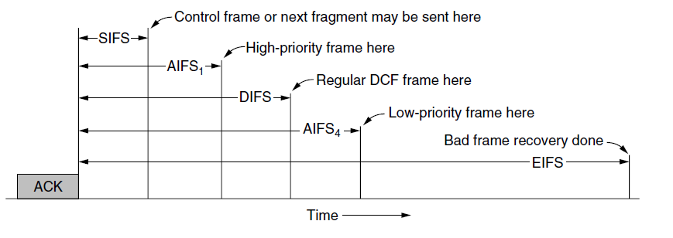
Interframe timing for QoS purposes
SIFS (Short InterFrame Spacing)
DIFS (Distributed Coordination Function InterFrame Spacing)
AIFS (Arbitration InterFrame Space)
EIFS (Extended InterFrame Spacing)

Slide 66
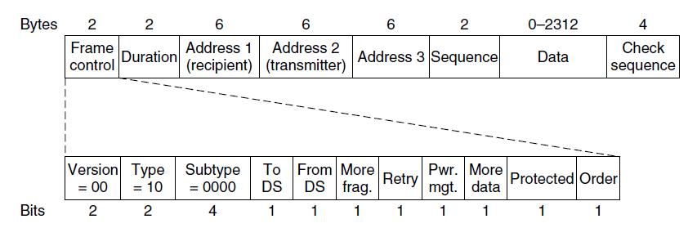
802.11 Frame Structure
Format of the 802.11 data frame

Slide 67
Hub
Hub is the repeating device of the physical layer:
Bits coming from one link will come out any other links with the same speed
No buffer frame
No CSMA/CD at hub:
Provides network administration function
twisted pair
hub

Slide 68
Connecting to hub
Backbone hub connects LAN segments
Extend maximum distance among nodes
But the segment's collision areas become larger
Unable to connect 10BaseT and 100BaseT
hub
hub
hub
hub

Slide 69
Switch
The switch is the repeating device of the datalink layer
Store and forward Ethernet frames
Check the frame header and select frame for forwarding based on the MAC target address
When the frame is forwarded on the segment, it uses CSMA/CD to access the segment
Transparent: Hosts don’t know the existence of the switch
plug-and-play: Switch does not require pre-configuration

Slide 70
Forwarding
1
switch
2
3
hub
hub
hub
How to determine which frame to be forwarded to LAN segment? Similar to the routing problem...

Slide 71
Ethernet switch
link-layer device: takes an active role
store, forward Ethernet frames
examine incoming frame’s MAC address, selectively forward frame to one-or-more outgoing links when frame is to be forwarded on segment, uses CSMA/CD to access segment
transparent
hosts are unaware of presence of switches
plug-and-play, self-learning
switches do not need to be configured

Slide 72



Switch: multiple simultaneous transmissions
hosts have dedicated, direct connection to switch
switches buffer packets
Ethernet protocol used on each incoming link, but no collisions; full duplex
each link is its own collision domain
switching: A-to-A’ and B-to-B’ can transmit simultaneously, without collisions
A
C’
B
6
1
2
5
4
3
B’
C
A’
switch with six interfaces
(1,2,3,4,5,6)

Slide 73
Switch forwarding table
Q: how does switch know A’ reachable via interface 4, B’ reachable via interface 5?
A
C’
B
A: each switch has a switch table, each entry:
(MAC address of host, interface to reach host, time stamp)
looks like a routing table!
6
1
2
5
4
3
B’
C
A’
Q: how are entries created, maintained in switch table?
something like a routing protocol?
switch with six interfaces
(1,2,3,4,5,6)

Slide 74
Switch: self-learning
Source: A
Dest: A’
switch learns which hosts can be reached through which interfaces
when frame received, switch “learns” location of sender: incoming LAN segment
records sender/location pair in switch table
A
A A’
C’
B
6
1
2
5
4
3
B’
C
A’
MAC addr interface TTL
A
1
60
Switch table
(initially empty)

Slide 75
Switch: frame filtering/forwarding
when frame received at switch:
1. record incoming link, MAC address of sending host
2. index switch table using MAC destination address
3. if entry found for destination then {
if destination on segment from which frame arrived then drop frame
else forward frame on interface indicated by entry
}
else flood /* forward on all interfaces except arriving
interface */

Slide 76
Self-learning, forwarding: example
Source: A
Dest: A’
A
A A’
frame destination, A’, location unknown:
flood
C’
B
destination A location known:
6
1
2
A A’
A A’
A A’
A A’
selectively send
on just one link
A A’
5
4
3
B’
C
A’ A
A’
MAC addr interface TTL
A
1
60
switch table
(initially empty)
A’
4
60

Slide 77
Switches vs. routers
application
transport
network
link
physical
both are store-and-forward:
routers: network-layer devices (examine network-layer headers)
switches: link-layer devices (examine link-layer headers)
both have forwarding tables:
routers: compute tables using routing algorithms, IP addresses
switches: learn forwarding table using flooding, learning, MAC addresses
datagram
frame
link
physical
frame
switch
network
link
physical
datagram
frame
application
transport
network
link
physical

